Slide 1
Ancient Rome

Slide 2
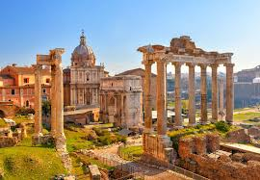
Rome wasn’t built in a day
Rome was established in the year 735 by a group of people called the Latins.
For many years Rome was ruled by a people called the Etruscans
The Roman’s learned many things from them such as how to pave roads, and build sewers (very important)
The Romans took what they learned from them and made their city great!

Slide 3
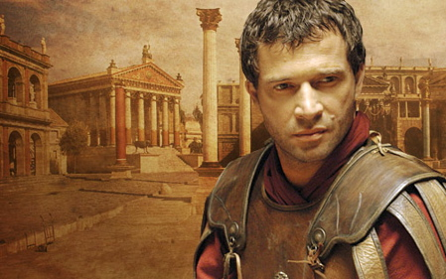
The beginning of a Republic
Horrible History Overview
Some kings were mean and cruel and treated the people badly. These kings were called tyrants, a cruel and oppressive ruler.
One king, named Tarquin, went to far and the people kicked him out and created a new government. Called a…
Republic
Notes:
http://www.youtube.com/watch?v=2kRwJJwxGZE (Roman Reports. First part deals with republic…then emperors. Maybe show twice.)

Slide 4
The Roman Forum
The forum was the city’s public square
Government buildings and temples stood on the hills around the forum
Many people met here to discuss issues and decided laws
Only citizens: people who could vote, were allowed to wear a toga

Slide 5
The Roman Forum
The forum was the city’s public square
Government buildings and temples stood on the hills around the forum
Many people met here to discuss issues and decided laws
Only citizens: people who could vote, were allowed to wear a toga

Slide 6
Roman Senate
A Republic is a type of government where people elect recent leaders to make laws for them.
To help make decisions the leaders looked to the Senate, a council of rich and powerful Romans who helped rule the city
The Romans were frequently at war with those around them. They elected dictators, rulers with almost absolute power, to lead them (for six month terms) during these times of crisis.
Read: How the Republic worked Pg 212

Slide 7
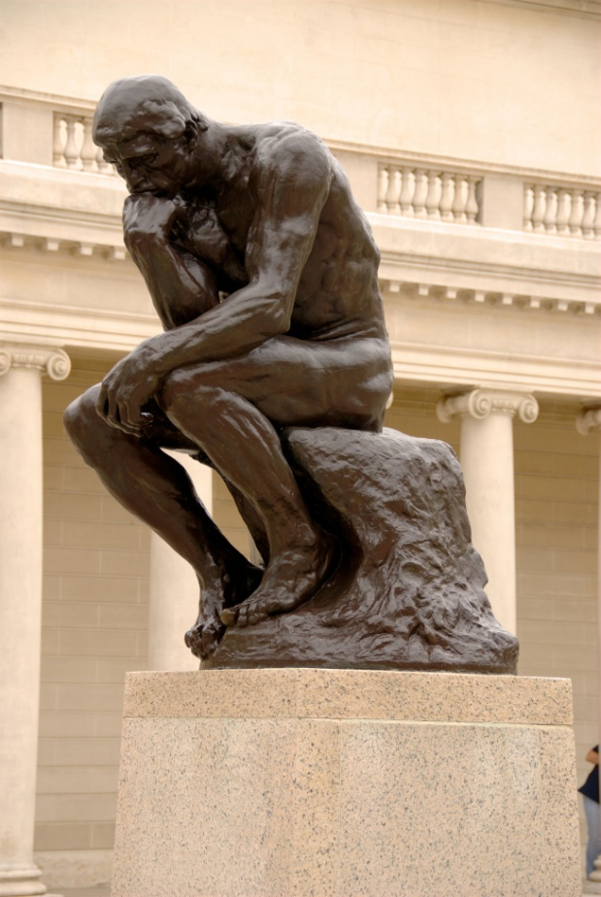
Think
Do you think that Rome was right to get rid of their king?
How is a republic different from direct democracy?
Which do you think is better? Why?
Turn to a friend and discuss . Then share with your teacher

Slide 8
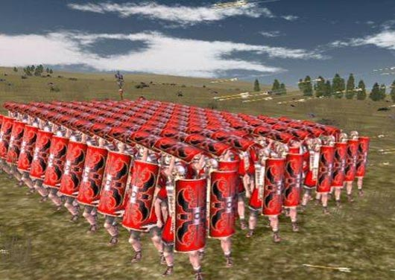
Consuls: two officials with limited power and one year terms; one controlled the army the other directed the government
Dictator: in times of crisis, the republic could appoint a leader with absolute power to make laws and control the army; power lasted for 6 months
Legions: military units made up of 5,000 soldiers

Slide 9
Rome Grows
After the formation of a republic, Rome began to expand their empire
They started taking over Italy but soon took over most of the known world
By 100 BC they had taken over most of the Mediterranean world
They were able to do this with their strong organized army

Slide 10
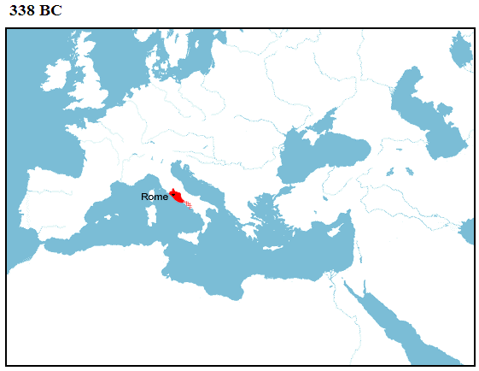
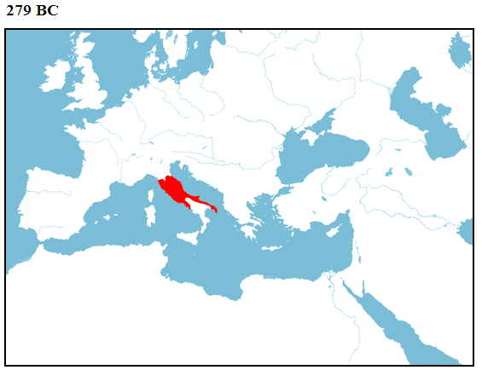
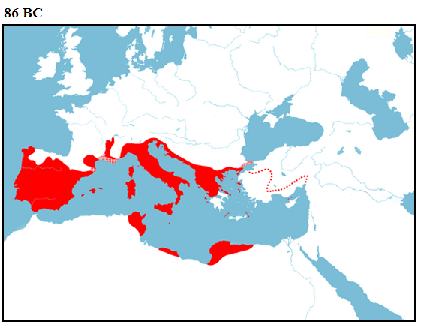
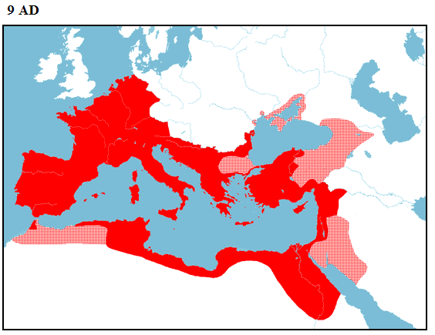
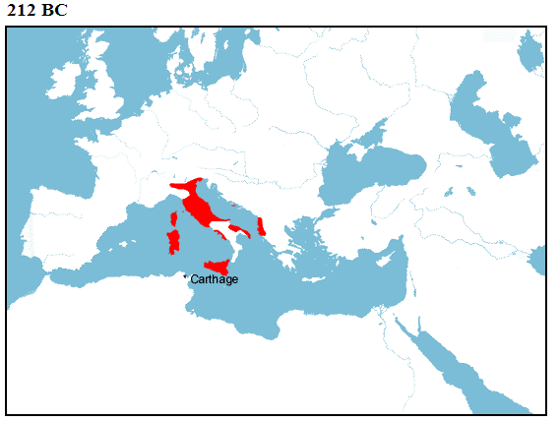
Roman Expansion

Slide 11
A Challenger Arrives!!
With its powerful Army Rome was now master of the Mediterranean world (this included Greece!)
However they had one rival who they could not conquer: Carthage
Carthage was a city in North Africa and they were very powerful
They did not get along with Rome.

Slide 12
Rome says: War!!!!
Punic war video (10 min)
Notes:
http://www.youtube.com/watch?v=BZrjXEomBXM (rome vs carthae show at end maybe…)

Slide 13
Punic Wars Definition and Causes
Definition
Causes
A Series of three wars between Rome and Carthage that lasted off and one from 264 B.C to 146 B.C (about 150 years!!!)
These were the largest and bloodies wars the world had seen up to this time.
Rome was expanding its empire to the east and west
Carthage was expanding its empire to the east and west
Both wanted to be rulers of the Mediterranean
They hated each other
A lot

Slide 14
Punic War I Tale of the Tape
Rome
Carthage
Powerful well trained army
Unique fighting style based on the Phalanx
Professional soldiers
Terrible Sailors…
Powerful well trained navy
Best known for their unique sea battles and skills
Army not as good as Rome's

Slide 15
What happened
Rome consistently defeated Carthage when they fought on land but couldn’t defeat them on water.
In order to win Rome needed to be able to battle at sea.
Luckily a Roman soldier found a burned out Carthage ship
They copied its design and used it to win the war.

Slide 16
Punic War 2: Hannibal’s Strikes Back!!!!!
Notes:
http://www.youtube.com/watch?v=E1NFrNv0Jis&list=UUAiABuhVSMZJMqyv4Ur5XqA&index=46&feature=plpp_video (Hannibal)

Slide 17
Hannibal assembled an army of 38,000 foot solders, 8,000 cavalry horsemen, and 37 elephants intent on capturing Rome
Hannibal arrived with only 20,000 foot solders, 4,000 cavalry, 2 elephants, and only 1 eye.
He led his troops up through Spain and crossed the Alps into Italy
Hannibal Musical

Slide 18
2nd Punic Wars causes
Soon after the first war Rome and Carthage had a problem with each other over who had the right to use Spain’s silver and gold mines
Hannibal, a brilliant Carthaginian general had enough of the arguing and decided to attack Rome
He terrorized the country side for weeks trying to get other Italian cities to join him. They wouldn't’ help Hannibal. Rome scared them more than he did.

Slide 19
Rome didn’t like this, so they sent their best general, Scipio, to attack Carthage.
Hannibal had to leave to protect his city
In a huge battle at Zama Scipio defeated Hannibal and won the 2nd Punic War!
Scipio vs Hannibal
Video
Notes:
http://www.youtube.com/watch?v=kXpOv_y5Y90 (Scipio vs Hannibal) http://www.youtube.com/watch?v=BZrjXEomBXM (another one)

Slide 20
Third Punic War
Carthage was now in ruins. They were just a small city, Rome had taken all their empire
However, many in Rome still remembered the attack by Hannibal and looked for a reason to attack Carthage again
One senator, Cato, constantly said “Carthage must be destroyed”
In 146 BC Rome attacked
Carthage, killed everyone and burned it the ground. They then poured salt on the ground so nothing would ever grow in Carthage again….harsh…..

Slide 21
Ticket Out
What were the Punic Wars?
Who was Hannibal, what did he do?
Who was the overall winner of the wars?
Questions for me?

Slide 22
HW
In a well thought out and well reasoned Paragraph (at least 10 sentences) tell me if you think Rome was right to burn and destroy Carthage in the last Punic war
Use at least 3 well written facts (meaning you can’t just say someone’s name) from your notes and include a topic sentence and a concluding sentence. If any of these things are missing points will be deducted
Due on Wednesday

Slide 23
Rome Expands
After the Punic Wars Rome kept expanding its territory.
They explored new lands and brought Roman law, customs and technology to all the world
The map shows the full extent of the empire.

Slide 24
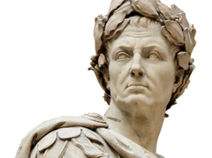
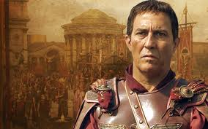
Julius Caesar
One of the people who helped Rome expand was a brilliant general named Julius Caesar.
With his army Caesar conquered what is now present day France and led the very first invasion of England
Caesar wanted to be the most famous and powerful man in Rome. To do this..he needed friends
Notes:
http://www.youtube.com/watch?v=nPYuxReh7fM&list=UUAiABuhVSMZJMqyv4Ur5XqA&index=22&feature=plpp_video (Caesar Video) Ask what facts they saw… http://www.youtube.com/watch?NR=1&v=h214xRwk7j8&feature=endscreen (and one more)

Slide 25
The Triumvirate
Caesar, his friend Pompey, and a leader named Crassus, all joined together and formed a group called The Triumvirate (which means 3)
They all worked together until Crassus died. Then Caesar and Pompey fought to see who would rule Rome.
Caesar won.

Slide 26
Murder!!!
The Roman senators gave Caesar the title “Dictator for Life’
This made a lot of people nervous
Two Senators, Brutus and Cassius, decided to kill Caesar and talked others into doing it as well.
Brutus used to be Caesar’s friend but was afraid Caesar was a tyrant.

Slide 27
On the 15th of March in the Senate Forum the Senators attacked and murdered Caesar.
They hid daggers in there cloaks and stabbed him.
“Et tu, Brute” was what Caesar said to Brutus before dying. It means “Even you, Brutus?”
Horrible Histories
Notes:
http://www.youtube.com/watch?v=eyq8uWvpbt4&feature=related (crime watch)

Slide 28
2nd Triumvirate
Brutus and Cassius thought they would be heroes, instead, the Romans hated them and wanted them punished.
Octavian, Caesar’s adopted son, and Marc Antony, Caesars best friend, joined with a man named Lepidus and formed the 2nd Triumvirate
They killed Brutus and Cassius and then began to fight each other for control of Rome
Octavian eventually won after defeating Marc Antony and his girlfriend Cleopatra in a sea battle.
Notes:
http://www.youtube.com/watch?v=pNWWl9yeTrk&feature=related

Slide 29
Caesar Augustus
Octavian took the name Caesar Augustus and declared himself Emperor of Rome.
The republic was over. The senate now had no power. It could only advise the emperor. Rome was now an Empire: a government that includes many different peoples and lands under one ruler.
A new age had begun.

Slide 30
The Pax Romana
Under Caesar Augustus Rome became great.
He was a wise and powerful ruler and used his talents to build up Roman Society
He financed libraries, built monuments, improved Roman roads, and made Rome a great place to live
After he died many Emperors followed in his exampled.
Because of theses accomplishments Rome had a golden age of peace and prosperity for over 200 years. This was called the Pax Romana or Roman Peace

Slide 31
Questions
Who was Julius Caesar?
Why did Brutus and Cassius kill him?
What was the first Triumvirate?
What was the Second Triumvirate?
Who was Octavian?
What is an empire?
What was the Senate’s job in the empire?
What was the Pax Romana?

Slide 32
Roman Achievements
Sas
During the Pax Romana and after the Romans created many achievements that we still use today
These achievements are in architecture, language, and religion

Slide 33
Roman Language
The language of Rome was Latin
Many of the Languages spoken today come from Latin such as Spanish, Italian, and French
The United States and other counties copied Rome’s Republic Style Government
Latin Phrases: In Pace Requiescat, Et tu, Brute,(even you, Brutus?) In vino veritas(with wine, truth), Esse Quam Verde(to be rather than to seem)

Slide 34
Architecture
Romans also built many great buildings and structures
One, an aqueduct was used to bring water into the city
Romans also built roads and the Coliseum
Notes:
http://www.youtube.com/watch?v=_bKQlQWyfzo (celtic vs. Romans technology. I use it to show how sophisticated Rome was)

Slide 35
Coliseum
The Coliseum was where the Romans held their sporting events
Some events they held were chariot racing, plays, and gladiator combat
The Romans loved violence and they Coliseum provided that
Notes:
http://www.youtube.com/watch?v=CWCwnkdPPCc (gladiator school)

Slide 36
Questions
What are some achievements of the Roman Empire?
What is the Coliseum?
What languages do we get from the Roman language of Latin?
What is an aqueduct?
Notes:
http://www.youtube.com/watch?v=dfSTZUEH95Q&feature=related (horrible histories colusium) http://www.youtube.com/watch?v=BIGyWwPcano&list=UUAiABuhVSMZJMqyv4Ur5XqA&index=20&feature=plpp_video (gladiator song)

Slide 37
Christianity
Christianity is based on the life, teaching, and actions of Jesus of Nazareth
Jesus lived at taught in the Roman province of Judea in Southwest Asia
He and his followers converted many people to the religion of Christianity

Slide 38
Spread of Christianity
Many of Jesus’ followers took advantage of the Pax Romana and travelled all over the world spreading his teachings throughout the empire
Many people converted to this religion, however some people did not like this

Slide 39
Persecution
The Emperors were worried about this new religion and began to persecute or punish those who were Christians
This only made more people convert
Notes:
http://www.youtube.com/watch?v=nO1NN2OcVcg http://www.youtube.com/watch?v=-cgfzaCja2c (both show examples of Christian persecution. The first is Nero’s human candles and the other is Christians vs lions. It’s horrible histories

Slide 40
Acceptance
In the 300’s a Roman Emperor named Constantine converted to Christianity and stopped the persecution
In 380 AD another emperor said that all other religions except Christianity. It was the official religion

Slide 41
The Church Gets Organized
The head of the Church was called the Pope
He appointed bishops and deacons to help organize the churches throughout the empire
After Rome fell the church helped hold people together

Slide 42
Questions
1. Who was Jesus of Nazareth?
What were his followers called?
How did the Pax Romana help spread Christianity
Who was Emperor Constantine? Why was he imporant?
Who is the Pope?

Slide 43
Fall of Rome

Slide 44
Rome, the strongest empire on earth, fell in 476 AD
Rome was invaded by barbarians who destroyed the city, kicked out the Emperor, and set up their own kingdoms
It was a bad time to be a Roman
But, how did it get like this?

Slide 45
Fall of Rome Reasons
Poor (or crazy)Leaders
Selfish People in the Government
Lack of Discipline in the Army
Lack of Loyalty to Rome
Barbarians invading from the outside

Slide 46
Poor Leaders/Selfish People
After Augustus Rome was ruled by only Emperors. The Senate could only give advice
When the Emperor was good things went well, when he was bad….well….not so much
Famous bad emperors include: Caligula, Nero, Commodus, and Elagabalus
Notes:
http://www.youtube.com/watch?v=2kRwJJwxGZE(Roman Report, just reviewing how many emperors there were)

Slide 47
The List….(and there are more)
Caligula: Tortured people for fun, had massive and expensive parties, killed people for no reason, declared war on Poseidon. Killed people he didn’t like.
(murdered by his own guards)
Commodus: Thought he was Hercules. Fought as a Gladiator. Killed Gladiators that were better than him (killed by the senators)
Elagabalus: made emperor as a young boy. Had a lottery for people but hid dead dogs, poison snakes, and bees in the prize boxes. (Murdered by Senators)
Nero: Killed his mother to gain power, killed his first wife, second wife, and half brother. Used to go out in the city at night and beat people up and rob them for fun. Burned Christians as candles. (killed by his own guards)
Notes:
http://www.youtube.com/watch?v=XNwLDsOcG_0(crazy Caligula)http://www.youtube.com/watch?v=u6ESsouohLg (Elagabalus Lottery) http://www.youtube.com/watch?v=VFBPRoaOLp4 (Nero Love) http://www.youtube.com/watch?v=U1MMkZnr364&feature=related (All emperors (I’m bad song)) (this one they loved. I had them write down facts and tell me which they though was the worst. There are more Elagabalus and Nero stuff online for Horrible Histories if you want it)

Slide 48
These bad emperors (and others like them) wasted Roman money and time
Their lack of leadership lead to Rome being disorganized, and weak
Their selfish greedy ways meant that Rome lost money and people got poor.
This caused Miliatry leaders to try to take over
While the leaders were fighting each other…the army was not training

Slide 49
Question
Which of the Emperors we heard about do you think was the worst? Why?
What do you think having bad rulers did for Rome?
How can being a bad ruler and being selfish hurt a country?
How can being selfish and bad hurt your school or team?
Share with a partner then with your teacher?

Slide 50
Lack of Discipline
Military leaders were fighting for the job of Emperor
Rather than training Roman solider the leaders recruited mercenaries from the barbarian tribes outside of Rome’s boarder to fight for them
This led to many of the soldiers (who weren’t Roman) not being loyal to Rome, but their tribes
?How do you think this might not be a good idea?

Slide 51
Solutions
One Emperor, Diocletian, to help stop the problems he saw in Rome split the empire into two parts East and West
The Western Empire was called Rome, the Eastern, The Byzantine Empire
The Eastern part of the Empire remained strong and did not fall (more on it in the Dark Ages), but the west…did not. …..

Slide 52
Barbarians Invade
As Rome was suffering from their own problems, they could not fight off the invaders when they came to take over Rome
Instead of fighting the barbarians many Emperors paid them off and let them live in Rome.
Some of the Mercenaries hired by Rome didn’t fight the Barbarians. They didn’t care. When they wernt’ paid, they attacked Rome.
Notes:
http://www.youtube.com/watch?v=jW3VZWjUVvw (barbarian magazine tells the different tribes)

Slide 53
The End….
In 476 AD The last emperor of Rome, Romulus Augustus (at little kid) was overthrown by Odoacer. Rome, in the west was over and the Dark Ages descended on all of Europe……

