Slide 1
India’s Caste System
Brahmin
Kshatriya
Vaishya
Sudra
If you lived in ancient India, how would you dived society into 4 distinct groups? What is your class structure?
Dalit
Untouchables
Caste
The system of dividing society into classes
Photostory Link

Slide 2
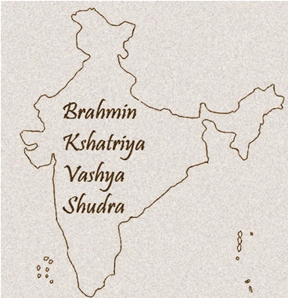
Developed alongside and became intertwined with Hinduism 1500 -1000 B.C.
The Hindu caste system (varna) was a result of the Aryan conquest of India and the conflict between conqueror and conquered

Slide 3
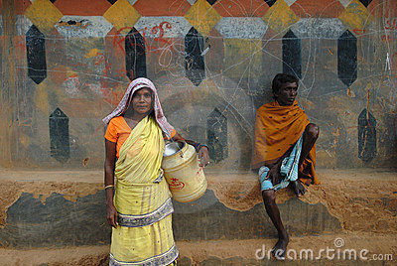
The Aryan invaders looked down on their subjects who where dark skinned, despite the fact that the civilization of the Indus Valley was more advanced than the Aryan civilization

Slide 4
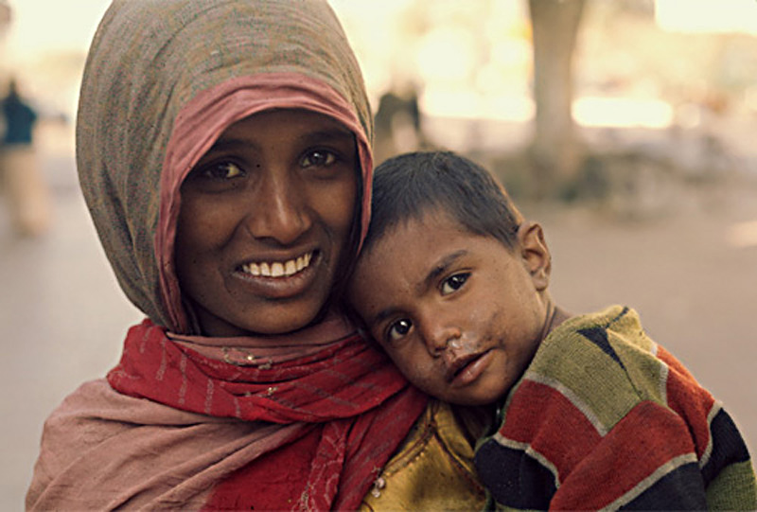
Your Caste
Determines:
Who they may befriend
Economic potential
Who they may eat with
Who they may marry
A persons occupation
Position in society
A person is born into their caste
With no way to escape it, even in death.
A persons caste is past down to the next generation
Caste System Overview

Slide 5
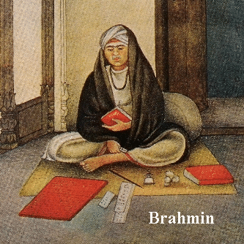
The highest class
They serve as priests, religious teachers, and judges
Their goal is knowledge and education
Traditionally held a great deal of power over Indian society
Priests perform a series of rituals that included religious ceremonies, presiding over weddings, births, and funerals
Only Brahmin men where allowed to attend school or to teach
Brahmin
Priests and Religious Teachers

Slide 6
Kshatriya were warriors and rulers
Include people of government and military positions
Made everyday decisions and ran the government
The Kshatriya had most of the power in everyday life, but their decisions could be overruled by the Brahmin.
Brahmin
Kshatriya
Warriors and Rulers

Slide 7
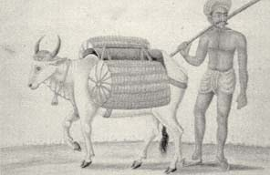
Their duties are to manage wealth and trade with other societies
Traditionally individuals in this caste are skilled laborers, focused in farming, agriculture, and trading
They require management and entrepreneurial skills
Today Vaishya work in the construction of temples, hospitals, and other public facilities
Although among the lower ranking of castes, they form a crucial part of society
Brahmin
Kshatriya
Vaishya
Skilled Laborers:
Merchants, Builders, Traders

Slide 8
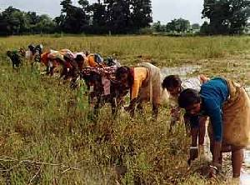
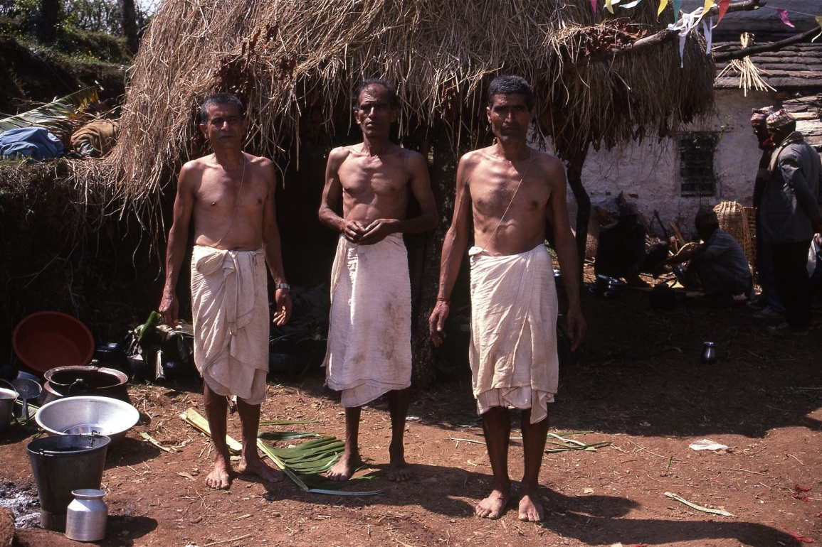
Sudra- The lowest group in the Caste System
They were usually servants and unskilled laborers
Their goal is to attain manual skills.
Their main duty is to serve other castes.
Often worked on the farms of higher caste members
The largest population of India
Brahmin
Kshatriya
Vaishya
Sudra

Slide 9
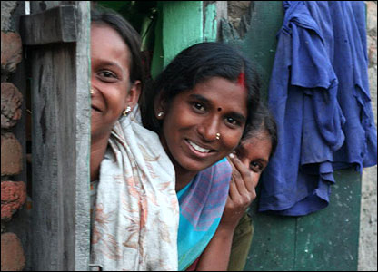
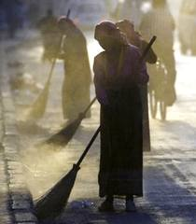
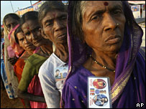
The Untouchables
Dalit
When the caste system began, the Dalit were believed to be subhuman, and therefore was not considered to be a level of caste. The dalit were lawbreakers, foreigners, people from isolated tribes, and people suffering from contagious diseases
They are called 'untouchables' because they engage in what are considered unclean occupations, such as tanning leather, removing dead animals, handling of the dead, removal of human waste, and garbage collecting.
Dalit have been described as being lower than human, filthy, and contaminated. Members of this castes are considered to be the untouchables. Highly discriminated against, the untouchables remain outcastes, even in modern society
Meaning:
Crushed and Broken
Video Link

